Slide 1


Girls and Autism
Yvonne Clark - Specialist Teacher for ASC
Specialist Teaching Service

Slide 2

Agenda
What is Autism?
Prevalence in girls
Presentation of Autistic girls
Teenage and Adult years
EBSA
Support Strategies
What Autistic girls want teachers to know

Slide 3

DSM-5 Four Areas of Difference
Social interaction
Understanding and using speech and non-verbal language to communicate
Flexibility of thought and behaviour
Sensory processing difficulties
Learning disabilities
High achievers

Slide 4
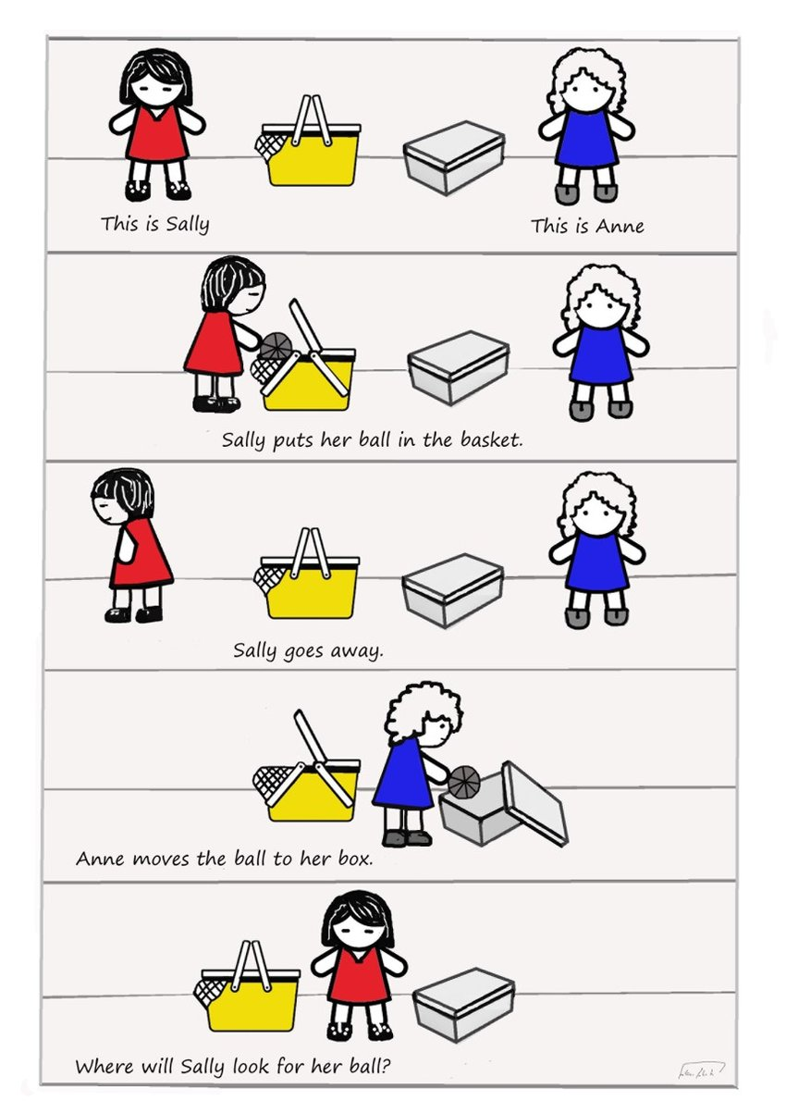
Social Interaction
Theory of Mind or ‘Mind Blindness’ understanding other people’s intentions, feelings and beliefs different from their own.
Sally and Anne test - Simon Baron-Cohen, 1985
New research into the lower production of Dopamine's / Oxytocin levels during social interactions (SCERTS) tracked from womb. Showing a preference for ‘things’ as opposed to people
May show socially unusual behaviours, eccentric, odd or aloof

Slide 5
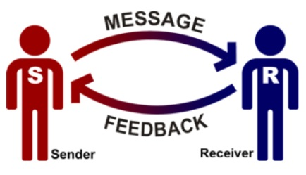
Social Communication
Pragmatics (Conversation skills) e.g., turn taking, talking over you, waiting, need to say what’s on their mind immediately, going off at a tangent.
Verbal and non-verbal language e.g., gesture / tone of voice / facial expression
Expressive language may exceed their receptive language skills
Literal understanding e.g. ‘You’re on fire’
Metaphors, idioms, sarcasm, jokes and rhetorical questions
Difficulty with complex instructions

Slide 6
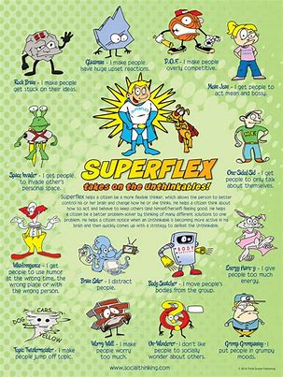
Flexibility of Thought and Behaviour
Difficulty with:
Changes in routine and unpredictability - ‘Tolerance of uncertainty’
Imaginative activities
Making choices
May present with:
Rigid thinking
Strong sense of justice and following rules
Restricted interests, obsessions and repetitive behaviours

Slide 7

Sensory Processing Difficulties
Autism is often accompanied by either hyper (over) or hypo (under) response to sensory stimulation
Taste (Gustatory)
Smell (Olfactory)
Touch (Tactile)
Sight (Visual)
Hearing (Auditory)
Balance (Vestibular)
Body awareness (Proprioception)
Inside body-pain, hunger, thirst, toilet (Interoception)

Slide 8

Additional Issues
Focus on Detail
Perfectionism
Organising, planning and sequencing tasks
Poor Generalisation
Physical difficulties
Fears and phobias
Sleep / eating

Slide 9

Video

Slide 10
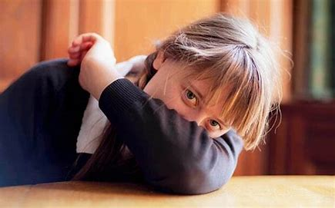
Why Girls Specifically?
Autism Spectrum Disorder (ASD) is often portrayed in a way that overlooks the unique experiences of girls and women.
This can lead to misdiagnosis and underdiagnosis.
Early intervention and support can reduce the impact on academic performance, vulnerability to EBSA, social development and mental health needs.

Slide 11

Statistics
1:57 (1.76%) school age children in the UK is diagnosed with Autism based on school records of 7 million state students (Aged 2-21)
Showed ‘boy-to-girl’ ratio at 4.3 : 1
(Study by Newcastle / Cambridge / Maastricht Universities - 28.3.21)
Figures suggest 80% of girls are undiagnosed by 18
Girls are diagnosed up to 6 years later than boys

Slide 12
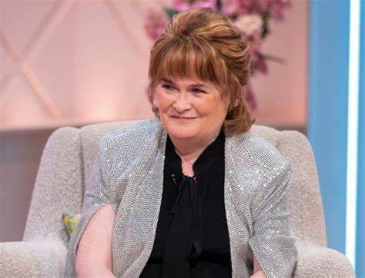

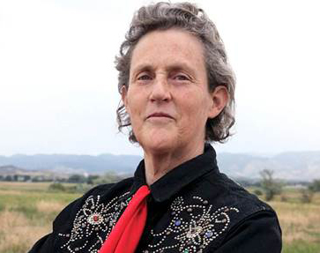
Autistic Women
Susan Boyle
Anne Heggerty
Temple Grandin

Slide 13

Task
Consider the differences between men and women:
What characteristics are naturally attributed to males and females?
What are men good at?
What are women good at?

Slide 14
Autistic girls vs boys
‘Autism aside - girls tend to be more socially aware than boys’ therefore:
Girls tend to have stronger social motivation and communication skills
Better at pretend play
Less prone to physical aggression but can still have meltdowns when younger
Better at ‘Masking’ than boys
Similar issues for Autistic girls and boys:
Struggle with unfamiliar social situations
Anxious with changes in routine
Socially vulnerable to peer pressure
Co-ordination problems

Slide 15
More subtle social presentation of Autistic girls
Might obsess over one friend or have imaginary friends
When frustrated may withdraw, tantrum, cry, appear moody or opt for selective mutism
May use correct gestures at correct times but these maybe learnt gestures
More gender stereotypical interests e.g., pets, crafts, literature, people
May withdraw if preferred friendship is not mutual or exclusive
May have a rich or complex fantasy world
Can be passive and shy to not draw attention to themselves
Notes:
Girls may not present in same way & so needs may not be recognised & therefore no referral for assessment is made
Where referrals are made diagnostic model may mean whilst need is recognised girls/women don’t meet criteria for a diagnosis
So if girls better at masking difficulties & aren’t presenting with same degree of need as boys why does it matter that they are appropriately diagnosed?

Slide 16
Autism Diagnosis
Girls maybe overlooked because:
Girls are often less disruptive than boys
Boys struggle with attention tasks more than autistic girls
Masking therefore hiding features
Diagnosed late
Some girls are assessed but the assessment tool is not sufficiently adjusted for the female ASC presentation. Based largely on male samples
Some girls come into the system late for diagnosis due to mental health difficulties e.g. depression, eating disorder, self harming.
Notes:
Diagnostic tool based on NT boy – deficit in a girl brings them in line with NT boy in the areas of the assessment.
Delayed imitation interpreted as imaginative play
Socially more common for girls to be seen as shy, polite, passive so if these traits are seen not immediately seen as being linked to ASC
Inappropriate support can result in:
increase in loneliness, social isolation, depression, lower grades, reduced future opportunities and achievements (Ashton Smith 2011)
May self-medicate e.g. with drugs or alcohol to cope with underlying difficulties or self-harm
Where girls are diagnosed need to consider gender specific challenges they face & therefore how we can support girls effectively to overcome these
May see passive rather than aggressive behaviours, where overwhelmed may be more like to shut down & withdraw than experience a melt down
Girls with Autism tended to engage in this behaviour in order to gain social attention, boys with Autism tended to engage in this behaviour in order to gain objects/escape demands (Reese et al 2005)
Girls more socially motivated so tried to conform & had more well developed coping mechanisms
girls’ presentation can often mean don’t meet criteria for diagnosis as these are based on observed male behaviours/presentations
Need to explore beyond a checklist when diagnosing & ask more probing questions to understand e.g. the nature of special interests. One woman with autism talks about liking knitting. Whilst this might not appear unusual, when questioned further about this hobby she explained that she had entire rooms in her house dedicated to every type of ball of wool, that each ball of wool was photographed & weighed & that these figures were then entered onto her computer. This would indicate a different & more intense interest in knitting than might initially have been suggested.

Slide 17
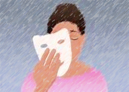
Masking
Masking is often associated with Autistic girls who copy peers from as young as 6 months old. They may not be aware they are doing it, as this is ‘normal.’
Girls have a greater capacity to mask autistic behaviours e.g., consciously deciding to suppress stimming movements.
“Putting on my best normal” by:
  Copying how others dress, use gesture, talk
  Learning social routines and rules which can feel ‘scripted’
  e.g., ‘How’s your day been?’
  May mask at school but have outbursts at home (Defensive Detachment Theory - ‘I wanted you and you weren’t there’)

Slide 18
Why Mask?
  Survival
  Avoids bullying
  To ‘fit in’ and be with people
  ‘Look less ‘different’ if hang around with people even if don’t like them.’
  Why is it a problem?
Suppression of authentic Autistic self
Can mean person is misdiagnosed
Losing sense of self
Socially isolated
Depression / Anxiety

Slide 19
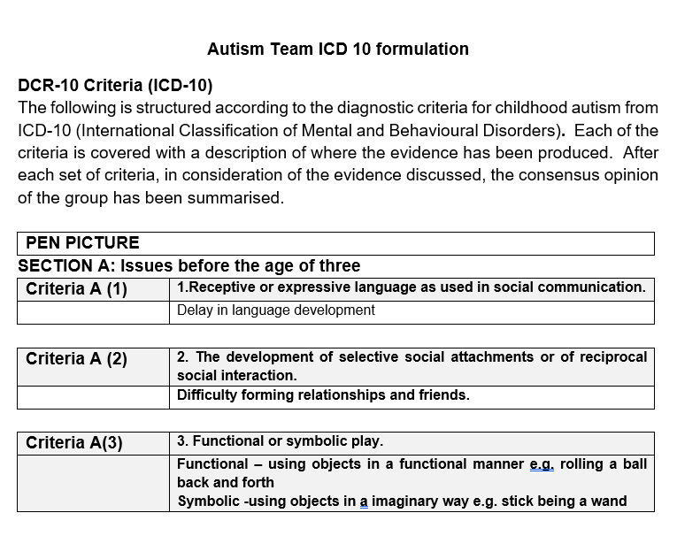

Slide 20
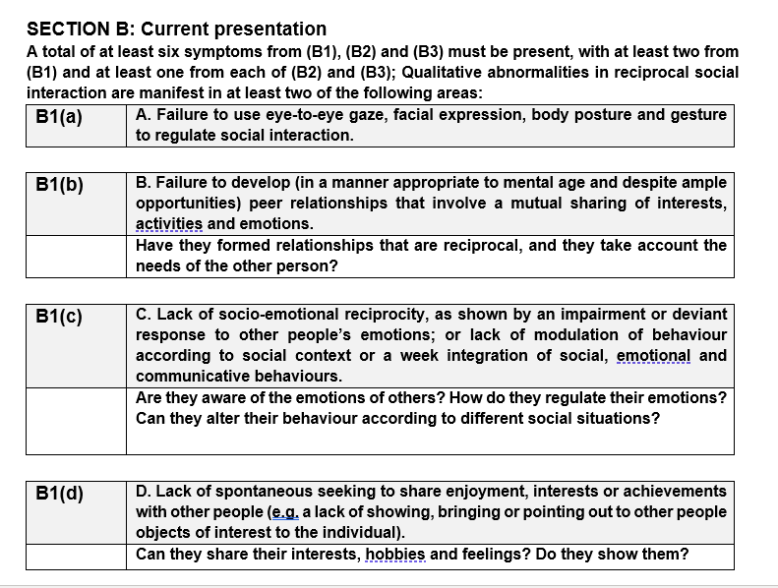

Slide 21

Anxiety?
Girls often internalize their problems and mask causing them to to be at risk of high levels of anxiety.
Catastrophizing thinking - ‘all or nothing’ / ‘Black and White’
Girls at risk of Perfectionism can drive anxiety
Studies shown elevated heart rate for sustained periods for some Autistic people leading to long term health needs and life expectancy.

Slide 22

Challenges in Teenage Years
Girls often struggle more at secondary school when social rules become too complex, causing isolation and confusion, resulting in possible mental health problems and EBSA.
Lack of or late diagnosis / intervention can leave girls vulnerable to developing associated mental health problems, anxiety and EBSA.
Notes:
Sometimes girls are assessed for autism at the point that they arrive in CAMHS/secure unit for support with an eating disorder. Why is there a high prevalence? Chicken and egg – which causes which??
-lack of early intervention can lead to later mental health problems developing
-starvation causes the brain to react in such a way that there is a similar presentation to autism eg social withdrawal, difficulty identifying and articulating feelings, narrow interest, rigid thinking – does this then lead to a false diagnosis??

Slide 23

Challenges continuing into Adulthood
Theory of mind:
Vulnerable to exploitation
Rigidity of thought:
Eating disorders-anorexia (Heathy vs unhealthy / sensory difficulties)
Sensory Needs
Personal hygiene
Fashion-soft, baggy / tight clothes
Social interaction:
Teasing/bullying
Social isolation - Mental health difficulties
Unhealthy relationships – seeking connection
Professional difficulties:
Sleep pattern
Difficulties with collaboration
Self-organisation
Notes:
Theory of Mind:
Vulnerable to exploitation: from partners & strangers can’t predict others’ behaviour, read intentions or differentiate between fact & fiction - increased incidence of DV or sexual harassment
Puberty & hormonal changes: can’t u/st own emotions, hormonal changes challenging & cause high level of anxiety
Rigidity of Thought:;
Eating disorders: rules governing food appealing leading to anorexia/eating disorders; exacerbated by changes to body during puberty which can cause anxiety, control with anorexia
Sensory Needs:
Make up: reluctance to wear or perfume
Personal hygiene: reluctance to use products due to eg smell, feel on skin
Fashion: may dress for sensory comfort vs follow fashion
All of above coupled with Social Interaction/Communication difficulties mean vulnerable to:
Teasing/bullying
Mental health difficulties: sustaining or u/st friendships, strain of repressing ASC traits lead to anxiety disorders/ depression, self-harm
Physically abuse or exploitation: can’t read body language
Social exclusion: not fitting in due to appearance or behaviour & interactions of women rely more heavily than men’s on language & emotional awareness, ruled by more complex unwritten social conventions, harder to integrate
Professional difficulties:
Unusual sleep patterns: challenge in successfully holding typically structured job
Understanding of social expectations within work place
May dominate & find collaboration challenging
Organisation: of self & workload (executive function)

Slide 24
Video - Limpsfield Grange School
Support Strategies

Slide 25

Break

Slide 26

Emotionally Based School Avoidance (EBSA) and Autistic Girls
CYP who experience challenges in attending school due to negative feelings (such as anxiety).
Associated with emotional and physical distress, and a
reluctance to attend school, which can lead to reduced attendance and further anxiety regarding school.

Slide 27
Who?
120,000 CYP were recorded as missing education at some point in 2022- 2023.
An increase of 23% from the year before.
Most deprived areas and “those in need of support.”

Slide 28
1) School non- attendance was “normalised”
2)Anxiety decreased for some,
“happier at
home”
3) A period of school absence can be a trigger
for EBSA
The Pandemic
4) Health concerns,
Caring responsibilities = risk factors

Slide 29

The CYP experiences significant distress in attending school and/or taking part in some aspects of school life?
Repeated lateness, followed by school attendance
Periodic absences, missing classes, not staying in class or avoiding some school spaces
Complete absence from school for a period of time
Complete school absence for an extended period of time
School attendence with anxiety
Behaviour in the mornings to avoid attending school

Slide 30

3)Gaps in learning
2) Family conflict and
distress
1) CPY Anxiety/ depression
Impact:
(short & long term)
7) Limited employment opportunities.
4) Family finances and MH
issues
6)Reduced social opportunities
5) Conflict- family/
professionals

Slide 31
 | Pupil | Family | School
Vulnerability / Risk factors | Fear of failure (Perfectionism) and poor self confidence Physical illness Transitioning between school years / settings Learning Difficulties, developmental problems, or Autism, particularly if unidentified or unsupported Separation anxiety from parent | Change in family dynamic e.g., divorce, separation or bereavement Parental illness or mental health difficulties High levels of family stress Parents with a history of difficult interactions with professionals Family history of EBSA | Bullying Ineffective behaviour management systems, e.g. inconsistent, unfair, punitive. Poor safety in the school (e.g. regular incidents where pupils are hurt) Dangerous and stressful school journeys (e.g. on bus) High levels of competitiveness within the school culture Poor pastoral care systems Lack of differentiation in lessons Academic /exam pressures Lack of an inclusive community feeling
Protective factors?

Slide 32
Resilience
The balance between Risk factors and Protective factors.
Fewer protective factors = more vulnerable to EBSA.

Slide 33

Interested but cannot meet
demands of the task.
Don’t feel included / accepted.
Leads to mistaken goals Stress Response
'Closed mindset'.
Not interested in the content.
Variable attention
Executive Functioning
Overwhelmed or
don’t remember.
Emotional dysregulation Sensory Processing Difficulties
Working memory challenges.
Why might some ND (Autistic) pupils not want to attend school?

Slide 34
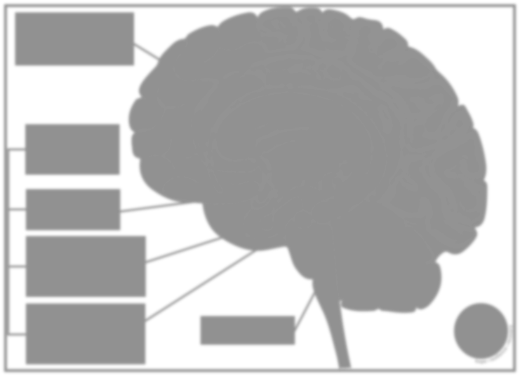
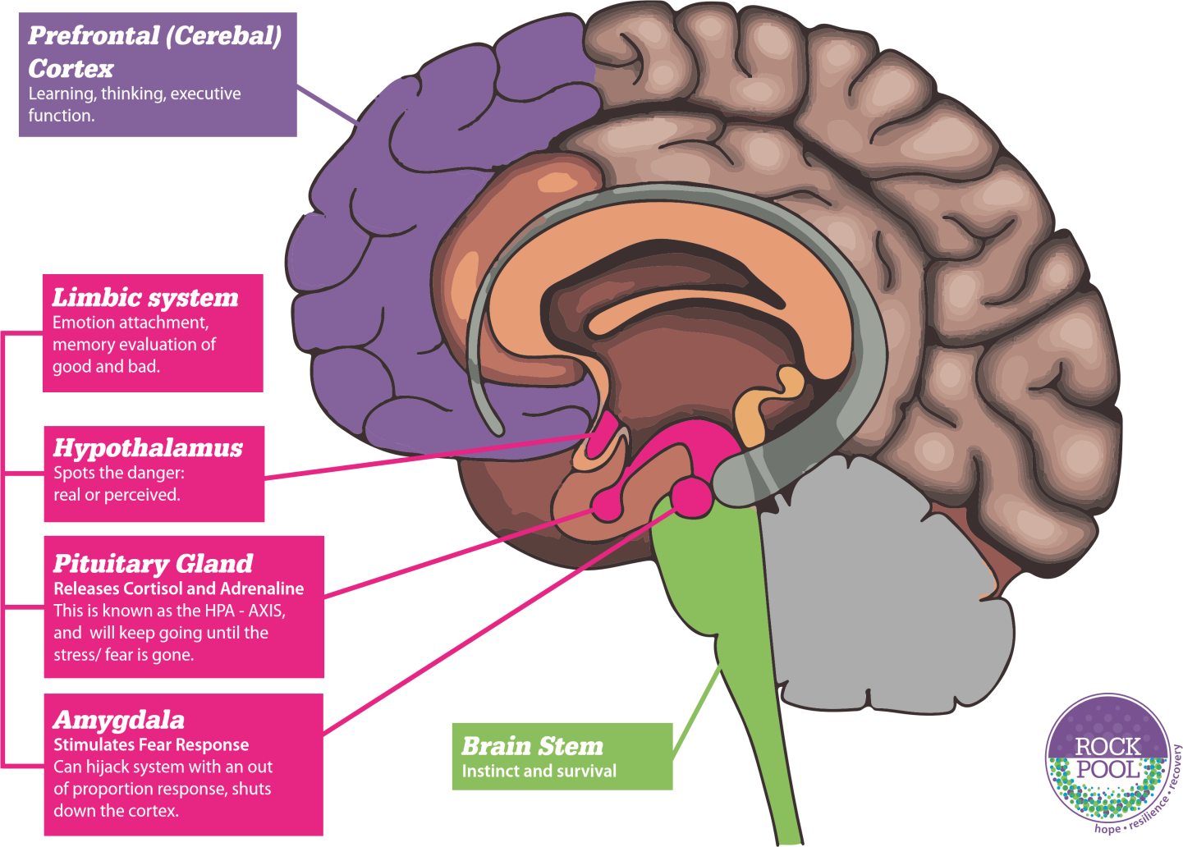
Anxiety
Avoidance
Long-term anxiety growth
Short-term relief from anxiety
Cortisol suppresses the immune system, more susceptible to infections. Ability to fight off illness is reduced.
Lower immune function and bone density, increased blood pressure, high cholesterol, higher risk of heart disease, digestive disorders and increased muscle tension.
Fight, Flight, Freeze stress response.
Cortisol interferes with learning and memory, poor concentration.

Slide 35
3) Repeated
lateness, unexplained absence
2) Separation anxiety at the gate or in car.
1) Reluctant to leave home, truanting.
Possible EBSA signs
4) Decline in
school performance/ attentional regulation.
7) Perfectionist tendencies.
5) Social withdrawal/ behaviour
change.
6) Complaints of physical symptoms.

Slide 36
2) Staff training on EBSA,
Anxiety, Autism
1) Focus on MH &
Wellbeing.
3) Attendance monitoring,
spotting patterns.
What can schools do?
7) Self calming strategies
4) Social Skills support
6) Robust lines
of communication home/ school
5) Focus on identified groups in transition planning.

Slide 37

Safe haven / break time support
Targeted opportunities to
raise self- esteem/ increase connections.
Catch up tutoring.
What can schools do?
Sensory audit
Adjustments:
Timetable, environment
In class: seating, lessen demands
Key adults

Slide 38
EBSA Risk and Resilience Cards

Slide 39
Landscape of Fear – Kate Ripley

Slide 40

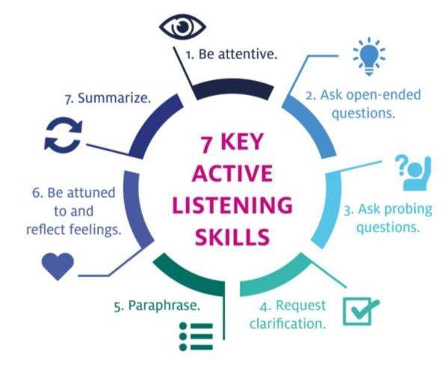
2) Model anxiety
management
strategies.
1) Morning routine.
3) Acknowledge their anxiety. Don’t collude.
What can parents/ carers do?
7) Specific plans for Sunday evenings.
4) Transitional objects.
6) Visual Planners.
5) Sleep routine.

Slide 41

What Autistic girls want teachers to know… (Honeybourne 2015)
Social Interaction
Many stated they felt invisible, shy, quiet and overlooked.
Wanting and needing time alone (Having a quiet space to take a break from being ‘socially on show’ as masking is exhausting)
Struggling to meet like minded students
Support maintaining friendships
Isolation at break and lunch time
Bullying

Slide 42

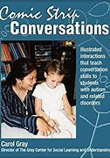
Social Skills
Help them understand the ‘hidden social curriculum.’ Social Skills groups can explicitly teach and practise these skills
Help them understand, misunderstandings on 1:1 without judging them so they can see another perspective (Social Stories / Comic Strip Conversations)
Pre-empt potential difficulties e.g. puberty and sex education to reduce vulnerabilities

Slide 43
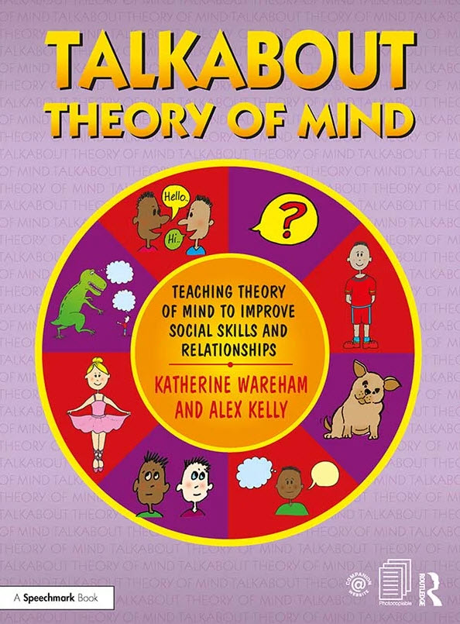
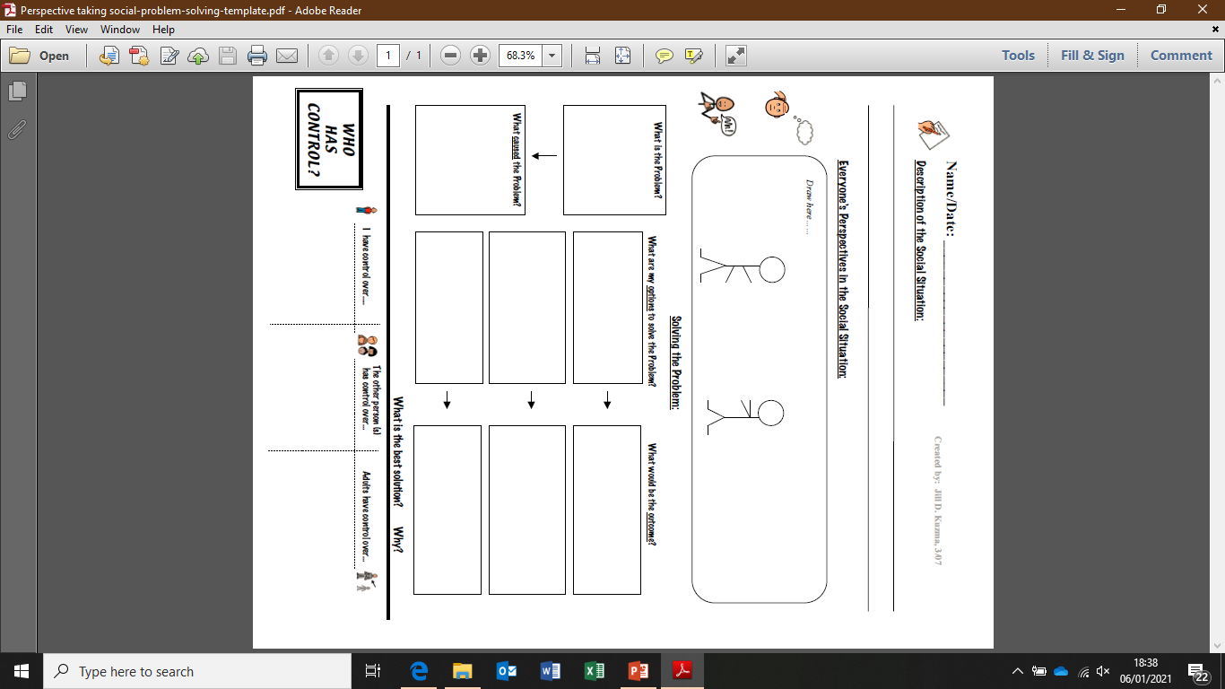
Theory of Mind Resources

Slide 44

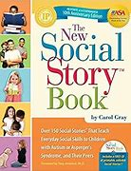
Unstructured Time
Break time/ after school clubs linked to their interests = provides structure and meeting like minded students
Safe Haven /Inclusion Base- able to ‘unmask’
/ Energy accounting
Identified Key staff to talk to (Triage)
Bullying Support – Carol Gray Chapter

Slide 45
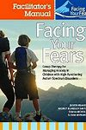
Anxiety / ASC Support Strategies
Validate their feelings ‘I can see this is hard for you…’
Many strategies interlink in helping to reduce anxiety by creating a ‘Tolerance of Uncertainty’ e.g., Mindfulness, sensory breaks, self-regulation, social skills, minimise uncertainty when possible, Gradual Exposure to the fear, desensitisation, back-chaining etc
‘Superflex’ programme (Rock Brain vs Flexible brain)
‘Facing Your Fears’ CBT programme specific to ASC (8-14) Body Maps – What/where anxiety looks like, Body relaxation techniques, Helpful vs Unhelpful thoughts. Size of the problem and steps to facing that fear.

Slide 46
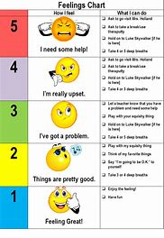

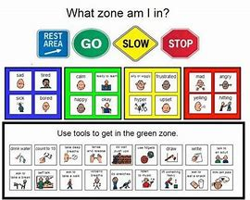
Self Regulation
The Incredible Five Point Scale
Zones of Regulation
Teach ‘I need a break’
Molehill Mountain ’ ASC specific App

Slide 47
What Autistic girls want teachers to know… (Honeybourne 2015)
Interpreting the world
Sensory Differences – noise, smell and staff with loud voices.
(Sensory Profile)
Rules needed to make sense and be applied consistently to avoid confusion, frustration and anxiety

Slide 48
What Autistic girls want teachers to know… (Honeybourne 2015)
Learning and Communication
Class discussions can be too fast paced (provide power point /notes to refer to before and after a lesson)
Some preferred to work independently rather than in a group (reduced social demands)
Some liked to learn independently, others preferred support of adult or catch-up classes

Slide 49


Slide 50

Further online training:
Woman and Girls
Online training Module by the NAS
£30 + VAT
online.training@nas.org.uk

Slide 51

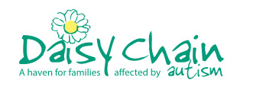
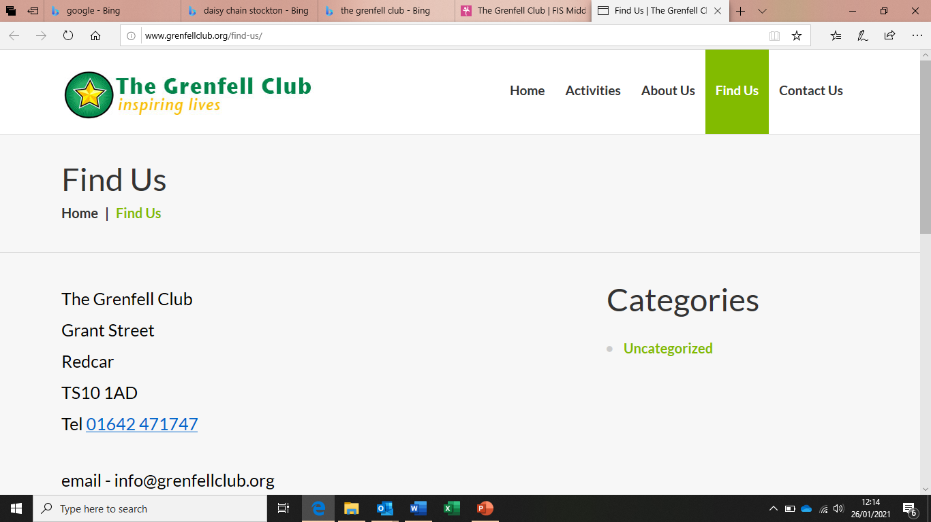
Signposting - Local Support Groups
Based in Middlesbrouugh (provides services across the Tees Valley Area) including short breaks for children, clubs for age 5 to adult, support for young people, parents and carers and professionals
https://www.iammain.org.uk/
tel: 01642 608012
e-mail: info@iammain.org.uk
https://www.daisychainproject.co.uk/
tel: 01642 531248
e-mail: info@daisychainproject.co.uk
Based in Stockton provides support for children, young people, adults, parents and carers
http://www.grenfellclub.org/
Tel: 01642 471747
E-mail: info@grenfellclub.org
Based in Redcar provides activities age 5 to adult

Slide 52
https://www.autism.org.uk/ | Comprehensive advice and guidance including access to resources and publications
https://carolgraysocialstories.com/ | Social Stories advice and information
https://reachoutasc.com/resources/ | Visuals, Social Stories, Mental well being, COVID 19, Transition
https://www.middletownautism.com/ | Wide range of resources from early years to teens covering best autism practice, social skills, life skills, sensory challenges, transition and resilience
https://do2learn.com/ | Educational resources for SEN: visual supports, social skills, behaviour management, job tips
https://www.twinkl.co.uk/ | Educational resources for SEN including visual schedules/timetables, now and then boards, social stories, 5 point regulation scales, social skills resources, reward charts
http://www.starsteam.org.uk/resources | Educational resources including personal development, social and emotional skills, sensory and transition
https://jillkuzma.wordpress.com/ | Social and emotional language skills resources and advice
https://www.elsa-support.co.uk/ | Emotional literacy resources
https://www.5pointscale.com/ | Incredible 5 point scale information and downloadable scales
https://www.babcockldp.co.uk/babcock_l_d_p/SEND/C-and-I/Documents/parents-autism-workshop/Cygnet-Week-3/NAS-Sensory-Guide.pdf | Guide to sensory strategies for children and young people with autism

Slide 53
Summary
Things that Neurological typical people find intuitive such as reading body language can be a mystery for people with Autism
Social situations can be overwhelming and stressful; therefore socialising can fill them with anxiety.
Girls can present differently to boys and learn to hide how their autism affects them

Slide 54


Slide 55


