Slide 1


Partnership for Inclusion of Neurodiversity in Schools
(PINS)
Community of Practice

Slide 2
Agenda
 | Item | Time |  | Presented by
1 | Welcome and Introductions | 15:30 – 15:35 | 5 mins | PINS Project Group
2 | Information Handout - Quick Wins | 15:35 -15:40 | 5 mins | Emma Hebb
3 | Emotionally Based School Anxiety (EBSA) | 15:40 -16:40 | 60 mins | Alison Wombwell Neurodiversity Specialist
4 | Any Questions and Close | 16:40 – 17:00 | 20 mins | All

Slide 3
Welcome and introductions

Slide 4
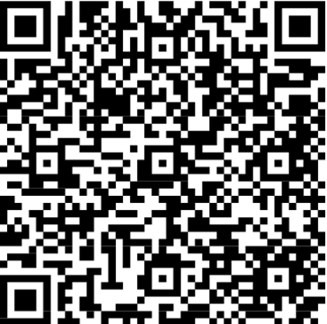
Quick Wins
Have an auto response on all emails. This would include a standard message such as “Thank you for your email we aim to respond to you in 3 working days”. This auto response lets a parent know their email has been received and may stop you receiving further chaser emails.
Design and display a “Contact Poster”, similar to your safeguarding posters. This provides an easy visual that shows parents how to raise concerns and with whom.
Refer parents and carers to SEND Family Voice, Parent and Carer Forum. We are here to work with you and parent carers to build relationships and support parents with training to upskill and build confidence in their parenting.
All resources are located on the Local Offer.

Slide 5


Slide 6


Slide 7


Slide 8


Slide 9


Slide 10


Slide 11


Slide 12


Slide 13


Slide 14


Slide 15


Slide 16


Slide 17


Slide 18


Slide 19


Slide 20


Slide 21


Slide 22


Slide 23


Slide 24


Slide 25
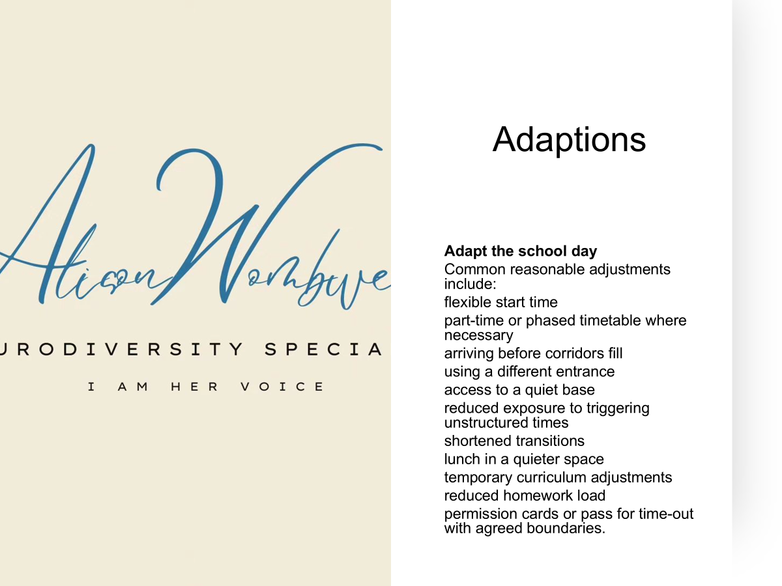

Slide 26


Slide 27


Slide 28


Slide 29


Slide 30


Slide 31


Slide 32


Slide 33


Slide 34


Slide 35


Slide 36


Slide 37


Slide 38


Slide 39


Slide 40


Slide 41


Slide 42


Slide 43


Slide 44
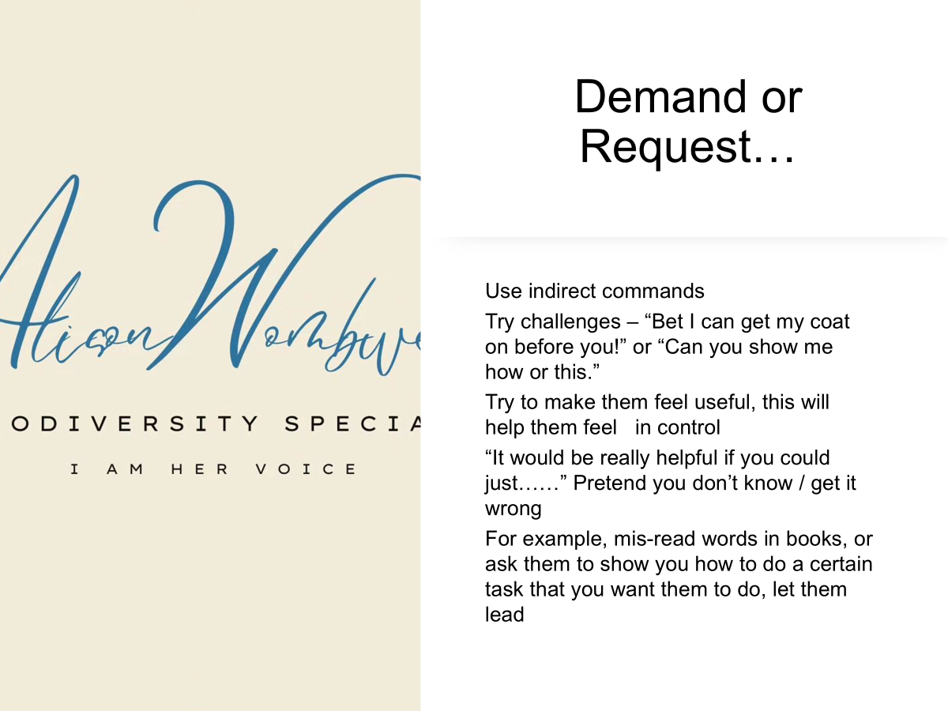

Slide 45


Slide 46


Slide 47


Slide 49


Slide 50


Slide 51
Any Questions?

Slide 52
Thank you

